Slide 1
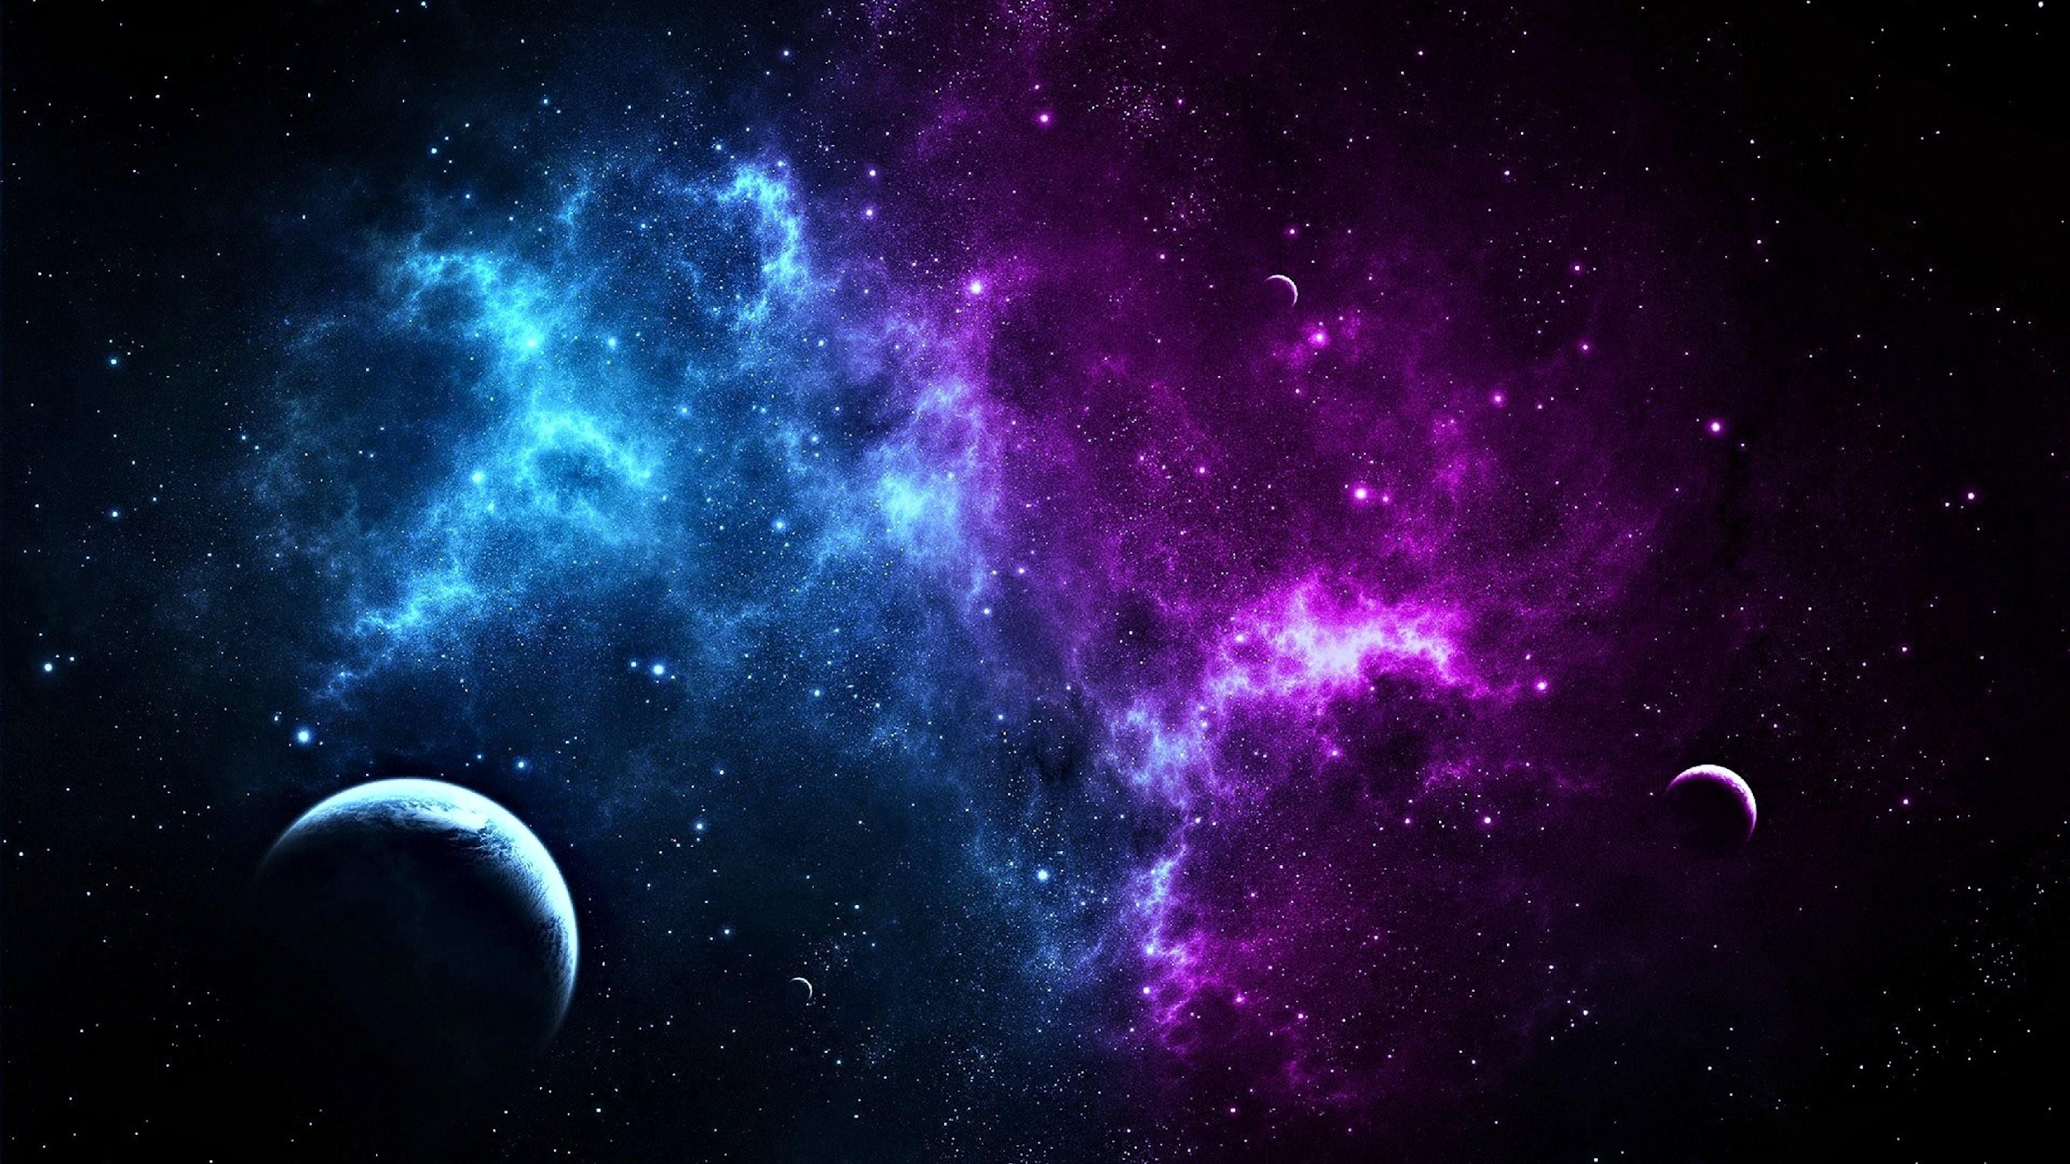
Invention Universe
Lab Book
Ian, Angela, Rachael and John

Slide 2
Problem
Many students apply to universities.
A small % of students are accepted.
Getting into the university of your choice can be difficult.
Mission
Create a portfolio (or Invention Universe planet) that will help you get into the university of your choice.

Slide 3
First, we need to design a luxury rocket ship to explore Invention Universe

Slide 4
First, we need to design a luxury rocket ship to explore Invention Universe

Slide 5
First, we need to design a luxury rocket ship to explore Invention Universe

Slide 6
First, we need to design a luxury rocket ship to explore Invention Universe

Slide 7
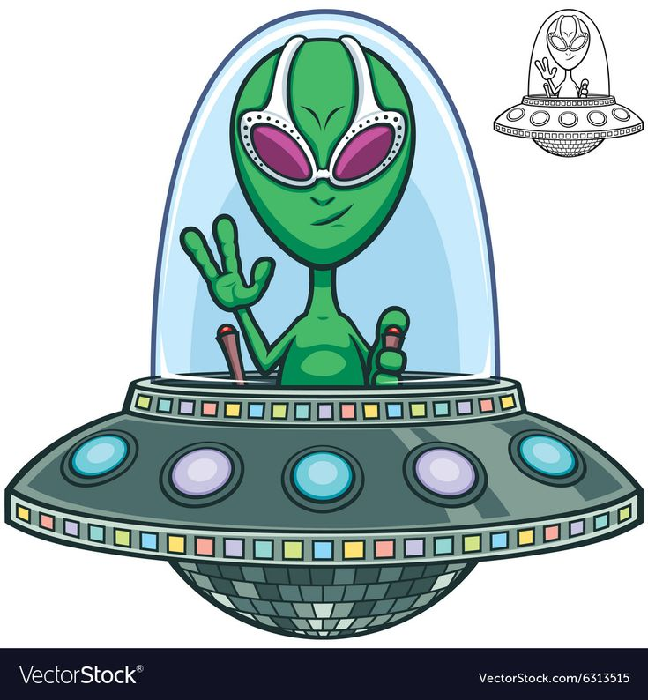
The Beatles wanted to live in a Yellow Submarine.
We all want to live in a purple people flying machine!

Slide 8
Drawing a ring around a planet can be tricky!

Slide 9
Draw two ellipses as guidelines for your planet ring
Use the curved line tool to draw a half circle. You may need to Edit Points to get the edges just right.
Duplicate this half circle.
Flip it.
Send it to the back.

Slide 10
The problem with this solution is that you will need to make this ellipse transparent in a pixel painting application if you want to make it work with any background.
What kind of a planet would you like to live on?

Slide 11
`
`
`
`
`
What kind of a planet would you like to live on?

Slide 12
`
`
`
`
`
`
`
`
`
`
`
`
`
`
`
What kind of a planet would you like to live on?

Slide 13
What kind of a planet would you like to live on?

Slide 18
Animated GIF
from GifMaker with no scaling

Slide 19
Copy as a bitmap so the outlines and text will scale with the drawing
vector
John’s Lab
John’s Lab

Slide 20
John’s Lab

Slide 21
Rocket Animated sequence:
We need to define the animation sequence frame.
Draw a box around the whole animation sequence
Make small invisible markers at the top left and bottom right to define the animation box.
Group the rocket and animation box markers.
Save each frame as a PNG.
Upload to Gif Maker.

